Slide 1


GUJARAT TECHNOLOGICAL UNIVERSITY Chandkheda, Ahmedabad Affiliated GOVERNMENT ENGINEERING COLLEGE BHAVNAGAR DEPARTMENT OF INFORMATION TECHNOLOGY
A Presentation On : CI platform
Under subject of
Summer Internship(3181601)
B. E. IV, Semester –VII (Information Technology)
Submitted by:
Name of student: Kajal Katariya
Enrolment No.: 190210116031
External Mentor
Sweety Patel
Internal Mentor
Prof. Sweta Garasia
Academic year
2023

Slide 2
Outline:-
Introduction
Purpose/Features
Features
Tools and Technology
Features Outcomes
Conclusion
Bibliography

Slide 3
Introduction:-
CI (Community investment / Community social investment / corporate social investment) platform can also be called employee volunteer program, workplace volunteer programs, corporate volunteer programs, company volunteer programs, and other iterations.
These programs are typically built to support a company’s larger corporate social responsibility program (CSR) or community engagement program or community investment program. Companies may have specific reasoning for building such platforms like building a positive brand reputation or increasing employee engagement in the community.

Slide 4
Purpose:-
To provide a platform for corporate employee to engage in available mission
It provides user-friendly interface to contribute in social/corporate activities, user can easily get list of activities/mission
It provides admin facilities like user create/remove, approve story requested by user, create/remove mission.
It provides real-time progress and impact of missions.
It enables individuals and organizations to launch and volunteer missions aimed at addressing social and community challenges.
It provides a platform for users to share their experiences and feedback as reviews of the missions they participated in.

Slide 5
Features:-
User registration and profile management: Users can register and create a profile that includes their name, location, skills, and availability. User can view/edit their details in profile page.
Mission creation and management: Admin can create missions and manage them, including setting a goal, location, and time frame for the mission.
Search and filter: User can search and filter available missions to volunteer based on country, skills, theme and city.
Mission Listing: All the available missions are displayed on this page which includes mission title, mission description, progress and goal of mission, availability of mission. User can view missions either by grid view or list view.

Slide 6
Features:-
Story Listing and creation: User can create story as a review and feedback that he/she experienced during mission. Admin review their story and after approval it will be visible .
Volunteering Timesheet: In this page, user can log his volunteering time on a set date. While logging, user can leave a note. Clicking on my profile drop down volunteering Timesheet will open.

Slide 7
Tools and Technology :-
Frontend: HTML, CSS, JavaScript,
Backend: Laravel, php
Database: Mysql
Framework: Bootstrap
jquey

Slide 8
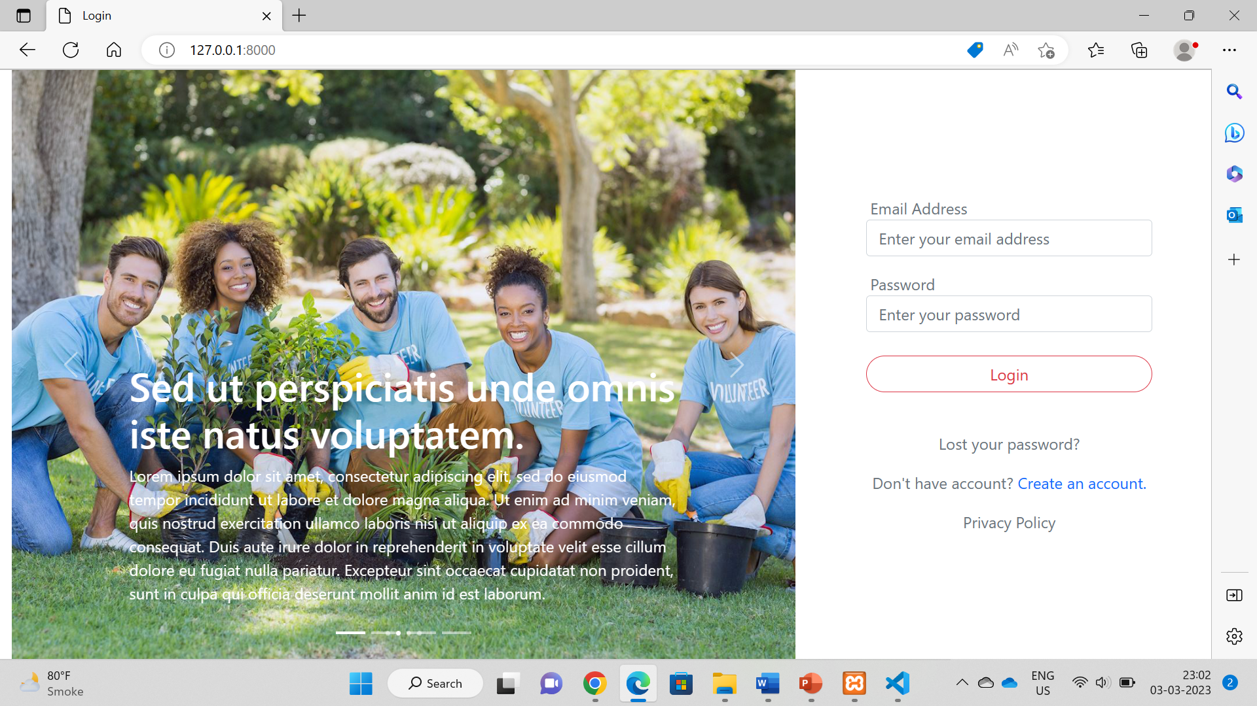
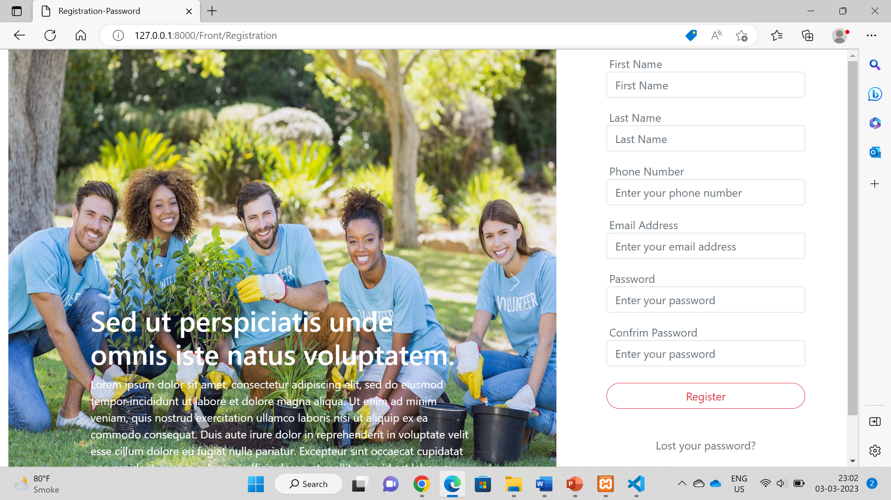
Output:- User :-

Slide 9
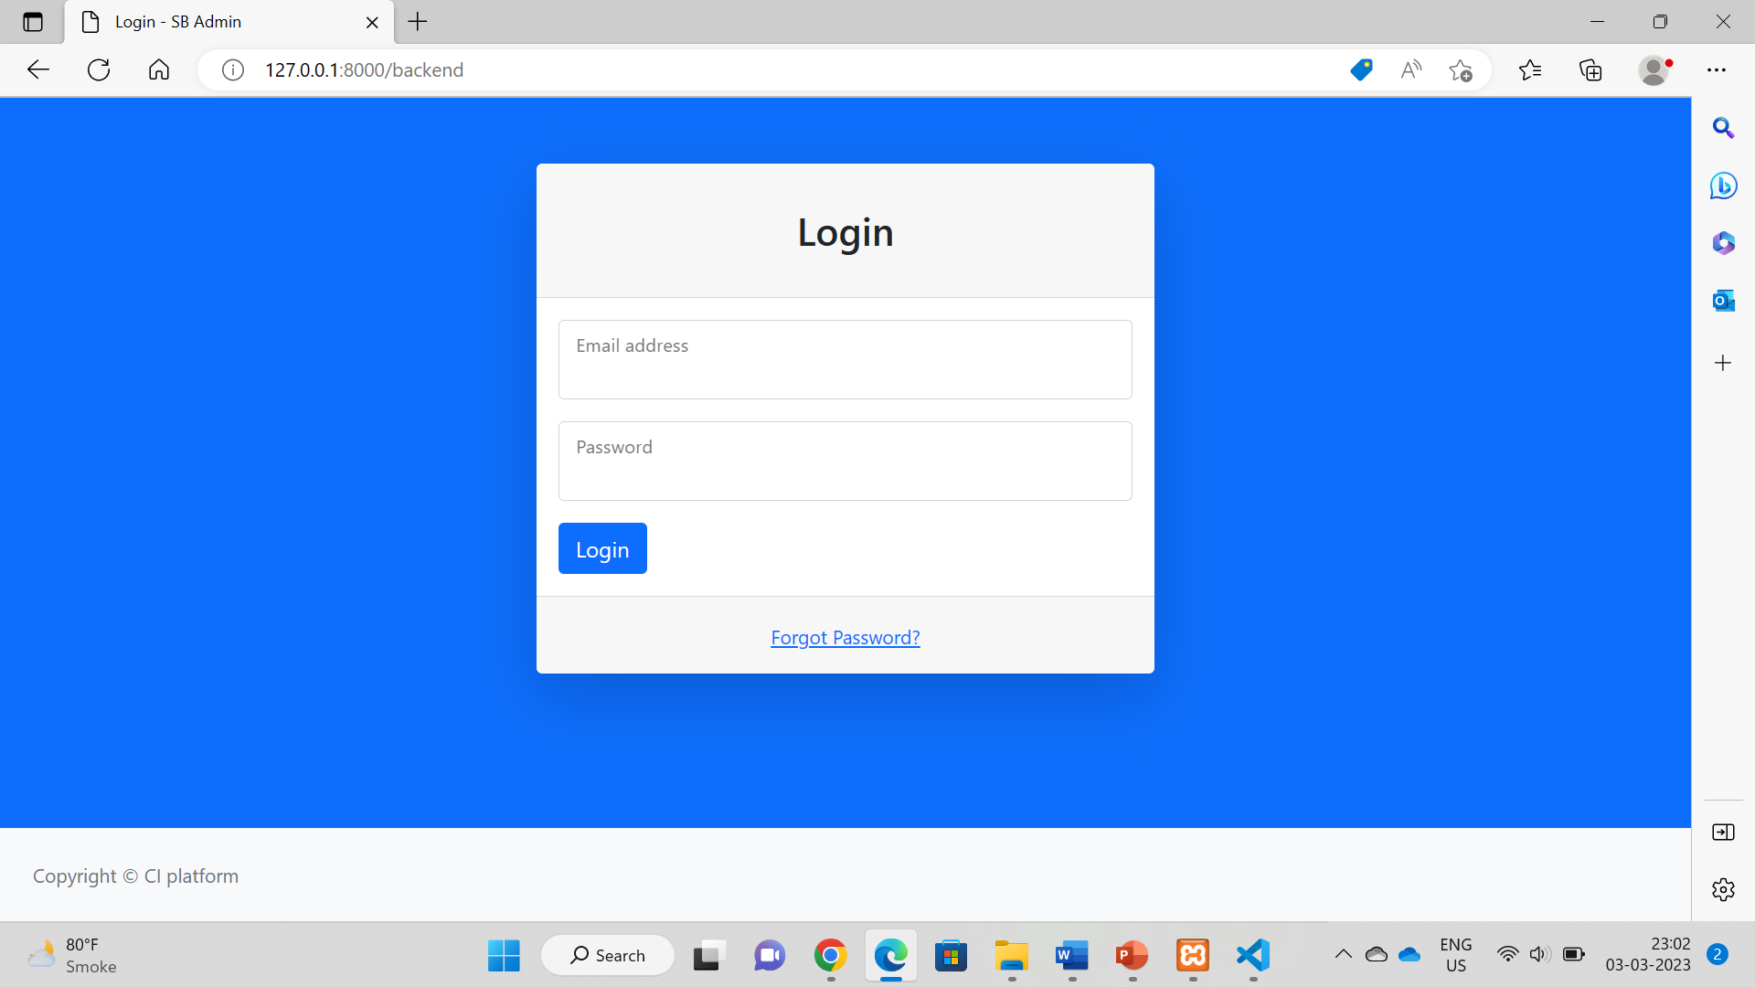
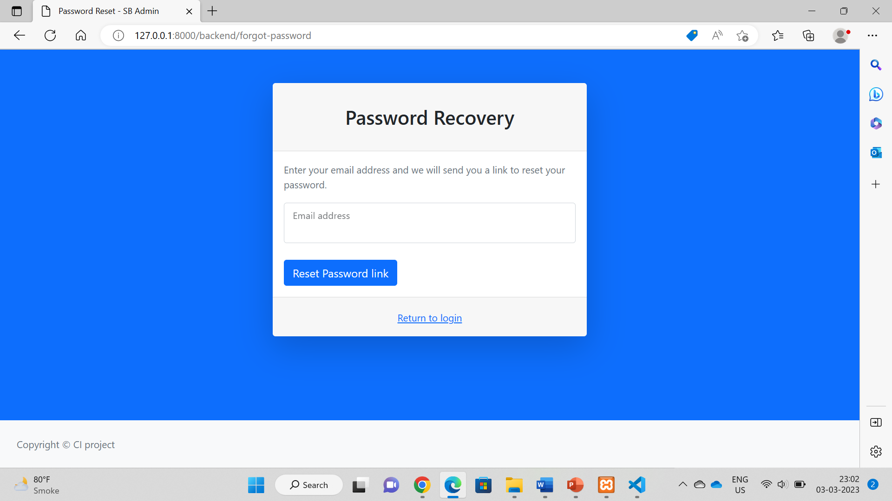
Admin:-

Slide 10
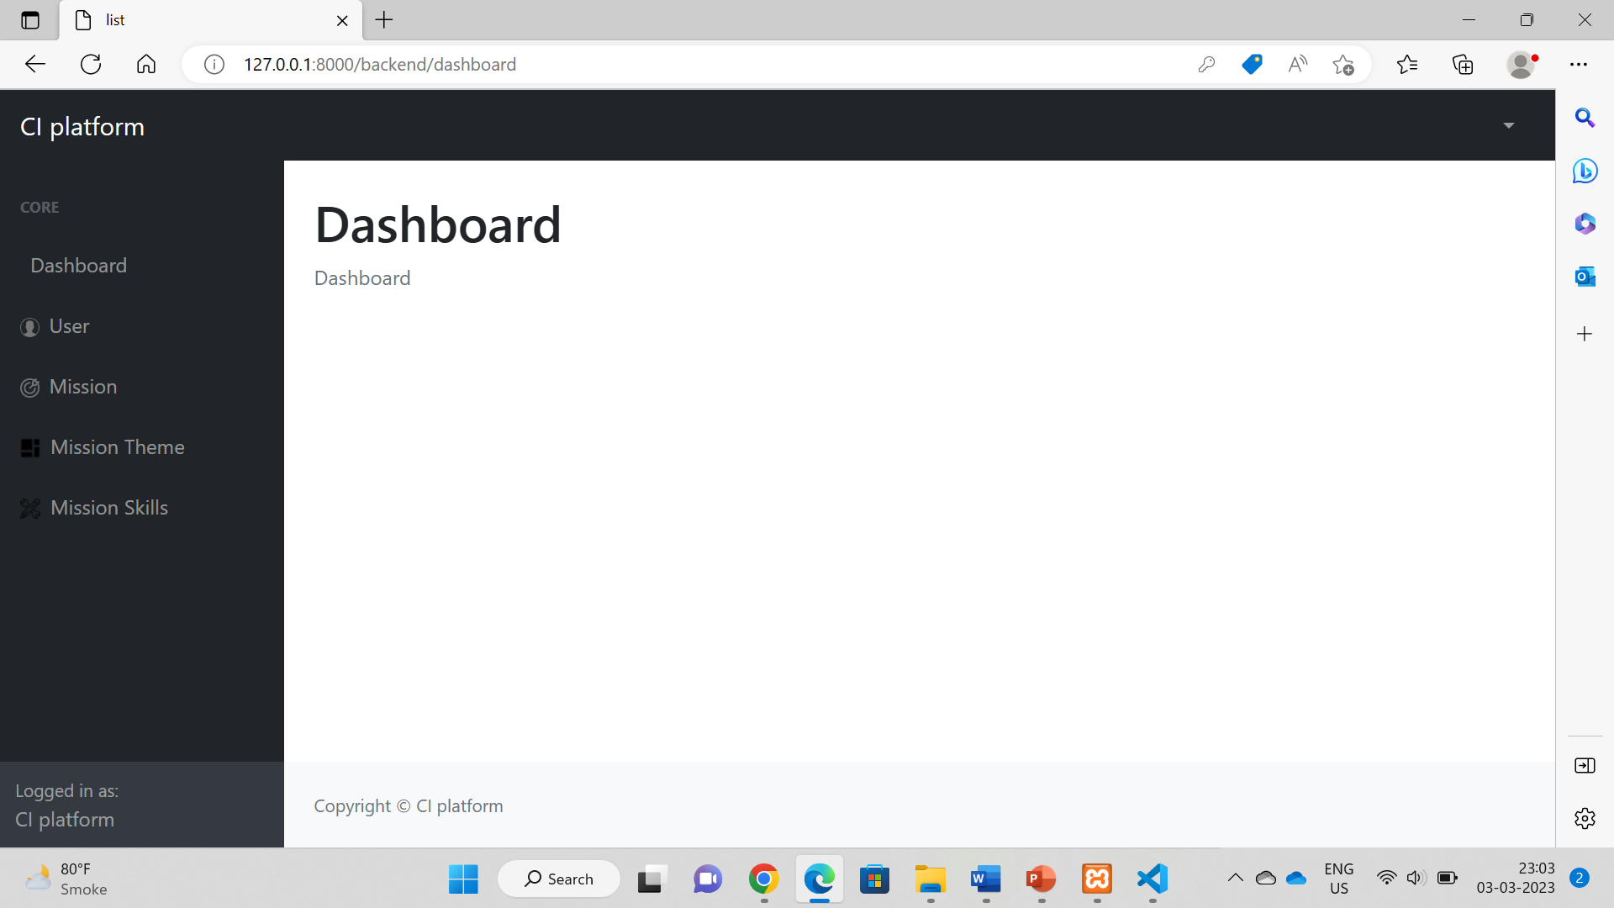
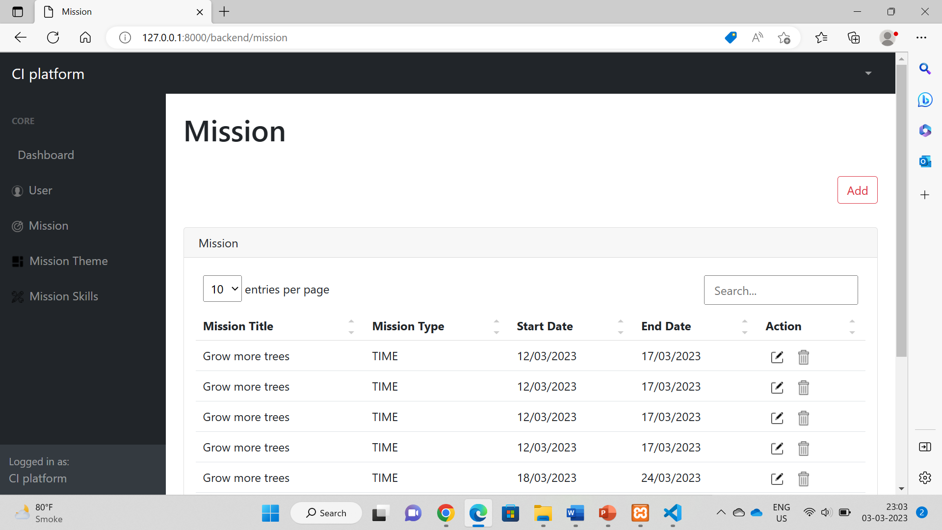
Mission:-

Slide 11
Future Outcomes:-
Improved transparency and accountability: The platform's data tracking and reporting systems could provide greater transparency around mission progress and outcomes, which could help build trust among users and supporters.
Strengthened networks and partnerships: The platform could help to build stronger networks and partnerships among community members, mission organizers, and other stakeholders, which could lead to more sustained and collaborative efforts to address social challenges.

Slide 12
Conclusion:-
The Community Investment Platform will provide a user-friendly and intuitive solution for individuals and organizations to launch and participate in missions. Users who participate in missions will have the opportunity to reflect on their experiences and share their stories with others, further inspiring and encouraging a sense of community and collaboration.

Slide 13
References:-
Website:
https://laravel.com
https://php.net
https://mysql.com
https://www.w3schools.com
External Guide: Sweety Patel
Internal Guide : Prof. Nishidh Chavda

